Slide 1
Team: CheeseDIP
Members: Neel Trivedi 20171015 (CSD)
Anchit Gupta 20171041 (CSD)
Kunal Vaswani 20171064 (CSE)
Project: PatchMatch
TA: Abhishek Prusty
Project repository: https://github.com/neel1998/DIP_Project_2019

Slide 2
Problem Statement

Slide 3
Reference Paper :
PatchMatch: A Randomized Correspondence Algorithm for Structural Image Editing
Connelly Barnes et al. link
Aim: This paper aims to provide interactive image editing tools using a new randomized algorithm for quickly finding approximate nearest neighbour matches between image patches.

Slide 4
Motivation
The motivation behind this proposed algorithm to be around 20-100x faster than the previously suggested methods is that to find the matching patch we don’t need search in whole image space, some good patch matches can be found via random sampling
And using the coherence in image we can propagate a matched patch via this algorithm to neighbouring areas quickly.

Slide 5
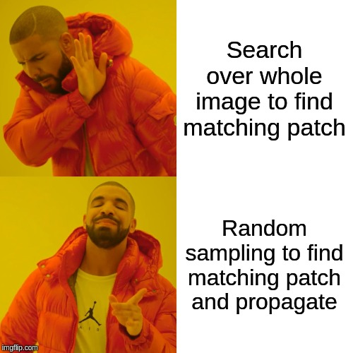
Since this method doesn’t iterate over the whole target image the computation time for this algorithm is almost instantaneous. And hence this method is used in interactive image editing tools widely where user can observe the results immediately. Random sampling to search for matching patch makes this possible.

Slide 6
Procedure and Algorithm

Slide 7
Nearest Neighbour Field (NNF)
The nearest neighbour algorithm lies at the coe of this procedure.
NNF is defined as a function f : A -> R² defined over all possible patch coordinates in image A. These values of function f() are referred as offsets.
The key insights that motivate this algorithm are that we search in the space of possible offsets, that adjacent offsets search cooperatively, and that even a random offset is likely to be a good guess for many patches over a large image.

Slide 8
Steps of the Algorithm
As shown in the diagram below the algorithm is divided into 3 main steps:
Initialization
Propagation
Random Search
Iterate

Slide 9
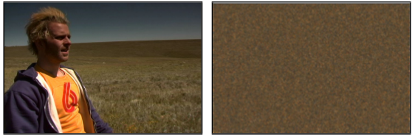
Step 1 : Initialization
As the title suggest in this step we initialize the offsets array.
There are two possible options here, we can either initialize the entire offsets array randomly or we can use some prior knowledge about the image and based on that we can initialize the region we hope to find the matching patch.
If we randomly initialize the offsets at the beginning of the algorithm the image looks something as under,

Slide 10
Iterations
After the initialization is done we move onto the main algorithm to find the matching patches
In each iteration we first perform “Propagation” followed by “Random Search”
In each iteration we basically aim to improvise our offsets matrix.
Offsets are examined in scan order (left to right , top to bottom) in each iteration.
Mostly we get desired results in 4-5 iterations.

Slide 11
Propagation
This step exploits the coherence property of images.
It is reasonable to assume that if we have good patch match at positions (x-1, y) (top) and (x , y-1) (left) we can use these offsets to improve the mapping at (x, y) position since due to coherency in the images the patches are likely to be same.
The effect of this is very important and that is, if we have found the correct mapping for (x, y) then all the locations below and to the right of (x,y) and having the same coherent region will be filled with correct mapping.

Slide 12
Random Search
In this step we attempt to find better candidate for our offset at position (x, y)
Let v₀ = f (x, y). We attempt to improve f (x, y) by testing a sequence of candidate offsets at an exponentially decreasing distance from v₀:
u_{i} = v₀ + wα^{i}R_{i}
Where R_{i} is uniform random variable in [-1,1] x [-1,1] , w is fixed search radius and α is search window ration.
We examine the patches for i = 1,2,3… until effective radius wα^{i} is less than one pixel and than update our NNF offsets with best found patch

Slide 13
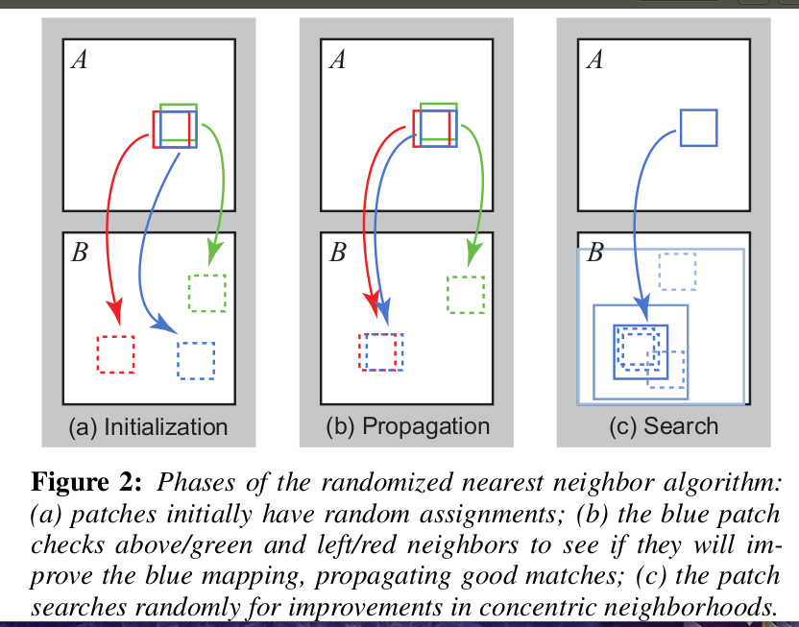
Illustration of the algorithm workflow

Slide 14
Applications

Slide 15
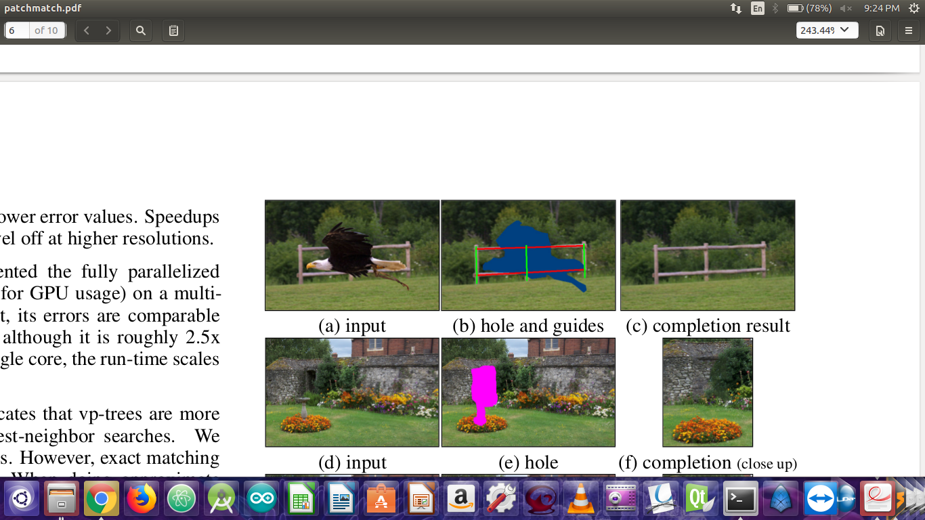
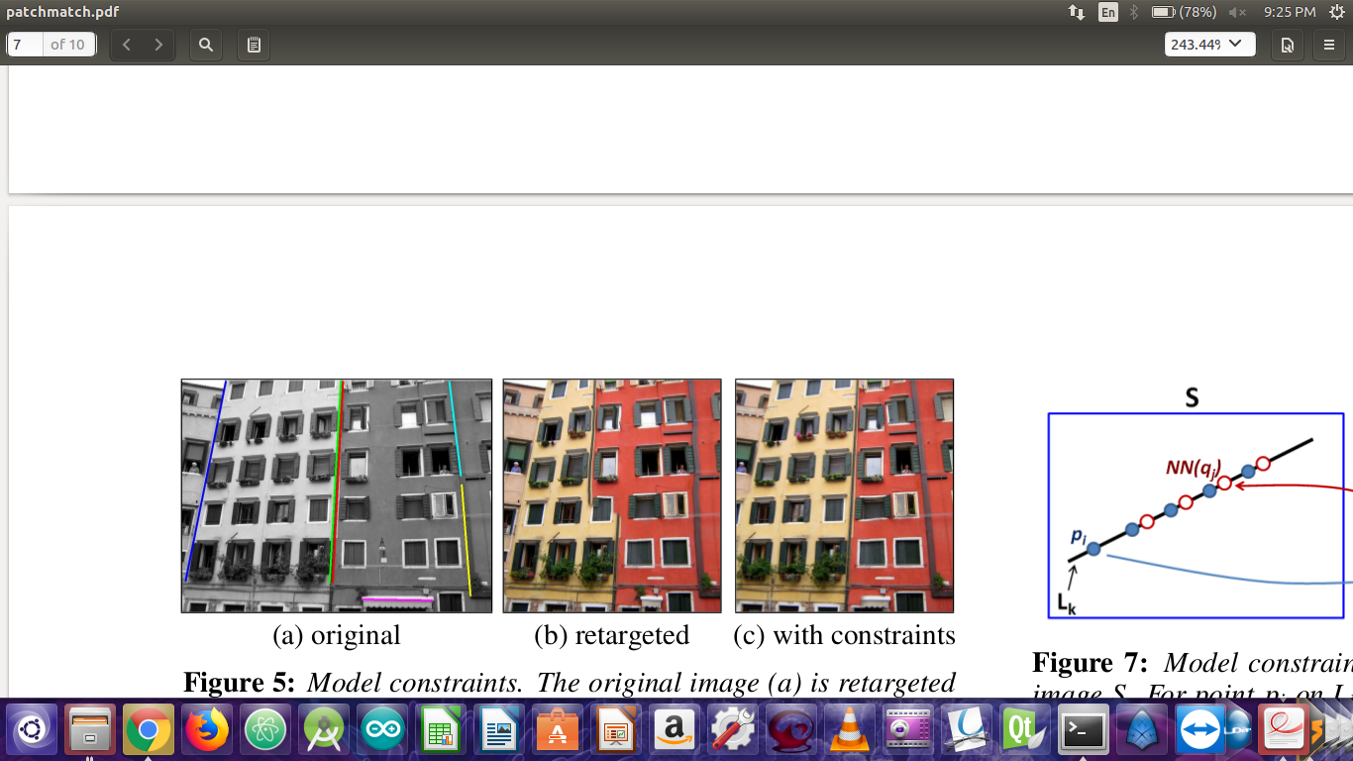
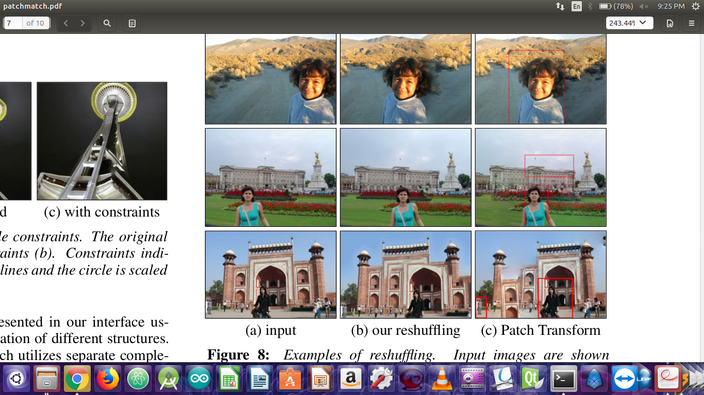
This algorithm is widely used in many image editing tools.
Objects removal
Image retargeting
Image shuffling
(This results are as per provided by the authors of the paper)

Slide 16
Results and Analysis:

Slide 17
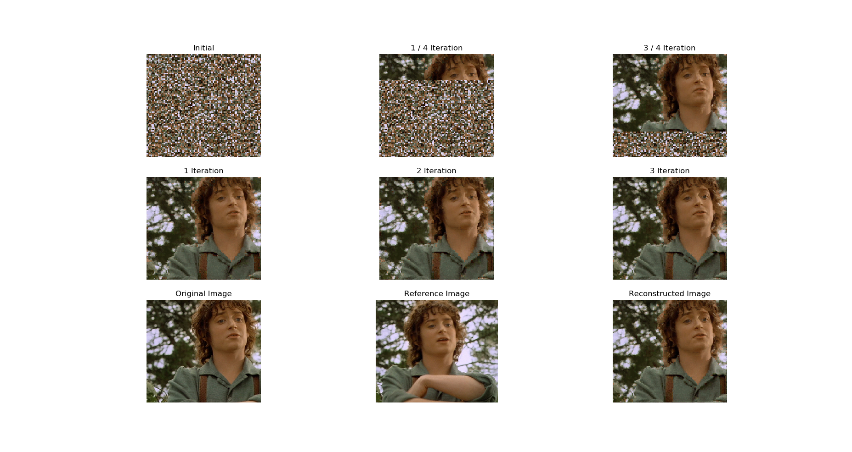

Slide 18
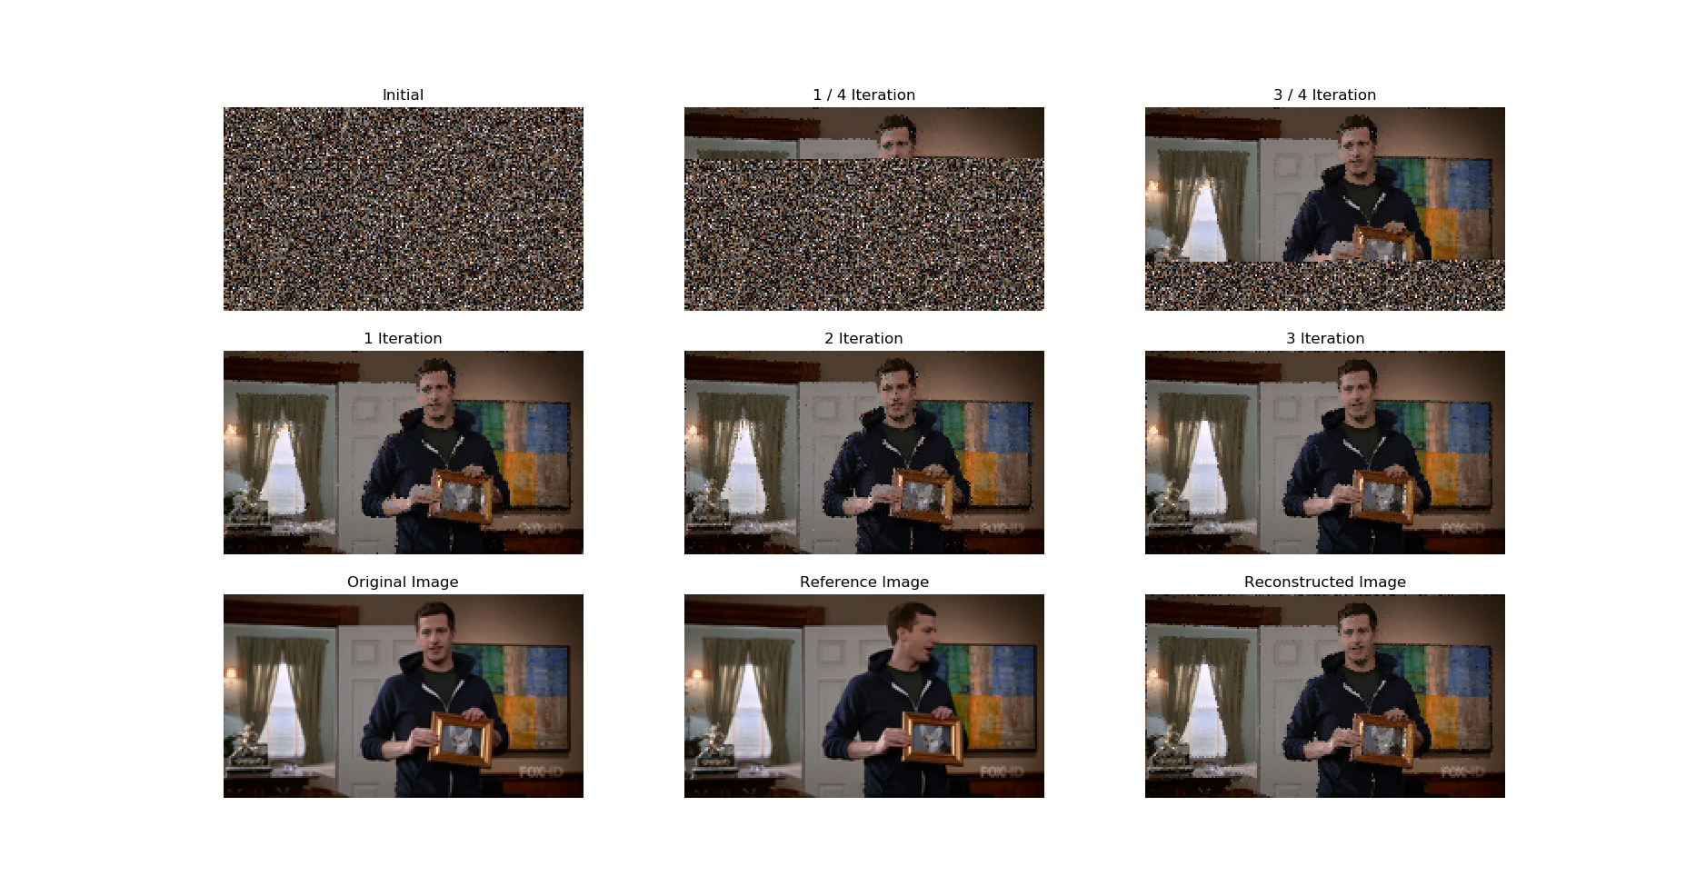

Slide 19
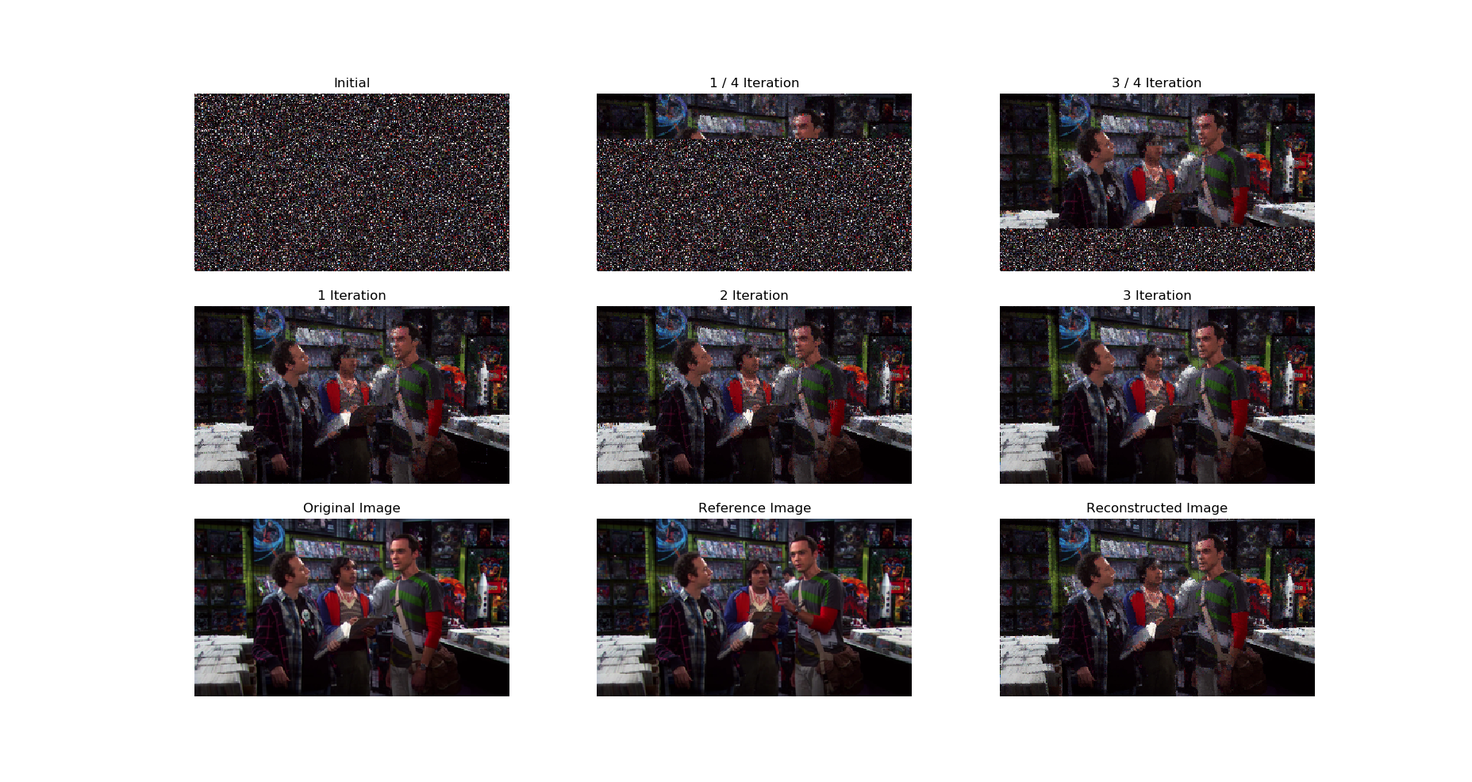
Limitations - Size of Feature

Slide 20
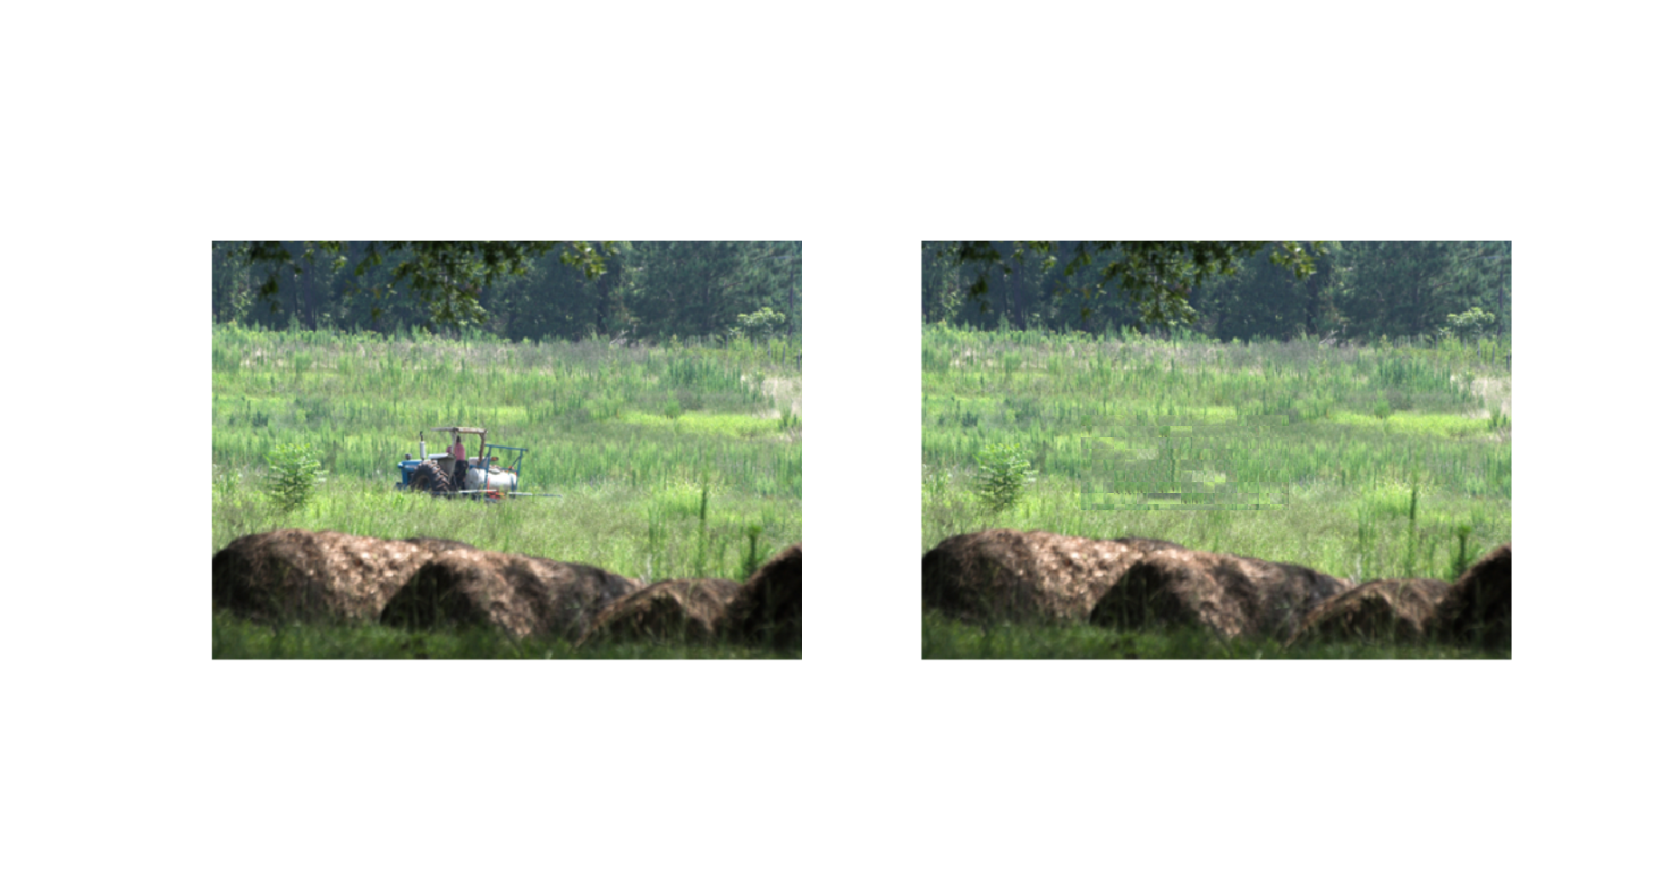

Slide 21
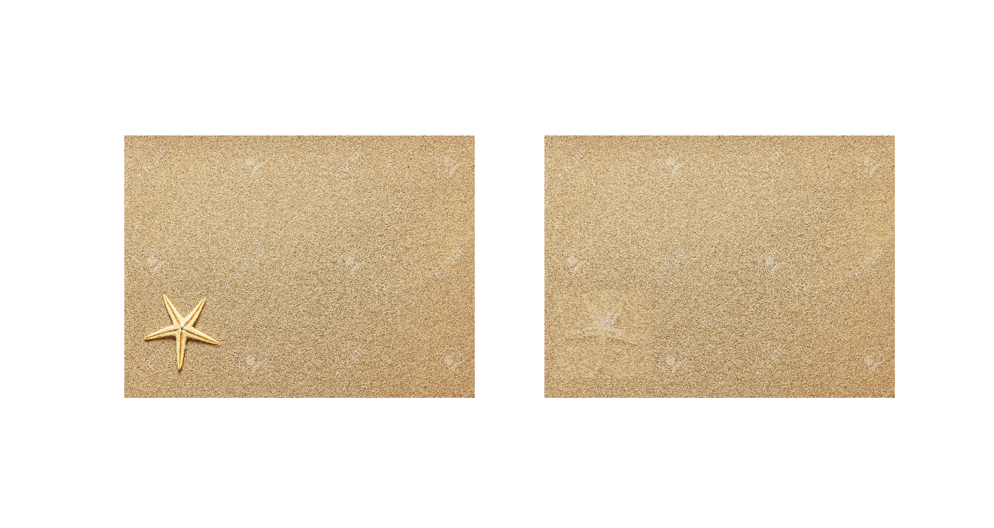

Slide 22
Further Discussions and Applications

Slide 23
Extensions of NNF algorithm
Instead of looking for a single nearest neighbour to find the best patch we could easily extend the algorithm to look for k nearest neighbouring patches and than analytically decide the best patch among this k nearest neighbours.
Even though all the application discussed so far includes images we can use this algorithm for video processing as well since videos are nothing but a temporal sequence of images we can also use temporal coherence across frames to better find patches across frames.

Slide 24
Work Distribution
Neel Trivedi
Basic NNF algorithm
Flask Application
Presentation and Docs
Anchit Gupta
Random Search implementation
Object removal tool
Code Refactoring and Result Production
Kunal Vaswani
Propagation implementation
Whole image matching tool
Result Production and Integration

